Slide 1
CLASSIFICATION AND TABULATION OF DATA
Presented by
Dr. Manjiree M. Vyawahare

Slide 2
What is data?
Data means facts & figures , raw information which is systematically gathered for the particular purpose from the various sources
Which has to be systematically observe, record and organize
Data are the basic inputs to any decision.

Slide 3
Classification
The classification of data means arrangement of data
Presentation means exhibition of data in clear and attractive manner, so that any one can understand and analyze the data
There are three different ways to present the data
Textual presentation when data is small in number ( easy to write & read)
Ex. Summarized data, comparative data
(ex. problem solving capacity in children, when we talk in terms of percentage, profit & loss, probability )
Use suitable, attractive, impressive data for textual presentation
Tabular Presentation
Diagrammatic presentation

Slide 4
CLASSIFICATION OF DATA
Primary Data
Secondary Data
Means original data
Data which is collected first time
Data which is useful for current studies and well for further studies
The data which is collected from the field under the supervision of an investigator
Ex. Your own questionnaire
Data gathered or recorded for some other purpose
Collected for a different context
It involves less cost, time and efforts ( as some one has already taken lot of efforts for that and have spent a money and energy )
Ex. Annual reports, census reports, financial reports, journals etc…

Slide 5
The ordered Array
After Data collection ……..
The first step is to prepare the data in an systematic order
Which is easy to understand
Study the facts about the arrayed data
Try to understand for what purpose this data is arranged ?
Gradually look at the ordered data , so that you can visualize the out put from this data
Your dream get shape and size ….once you apply statistical methods on it….

Slide 6
Grouping of data
Classify the data into different groups
Under some common characteristic
Geographical area wise
Class wise
Variable wise
Population wise
Time wise
Date wise
Gender wise
Area of interest wise etc…….
Requirement of your research topic …….

Slide 7
Arrayed data enables statistical treatment
Hypothesis can be formulated
Average can be calculated
Variations can be computed
Forecasting can predicted or built
Different statistical test can be applied
Chi-square test
Z-test
TTest
etc……

Slide 8
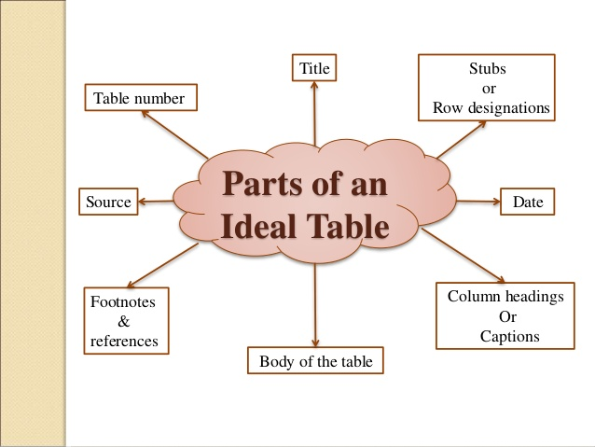
TABULATION OF DATA
Data should be compress into table
A table is a systematic arrangement of statistical data in rows and columns
Table should contain

Slide 9
Classification of table
Table can be classified into three categories
 | characteristic
1. Simple table | Only one characteristic shown
2. Complex table Two way table Higher order table | Two characters shows , either rows / columns is divided into two parts Three or more characters are shown then such table is called as higher order table
3. General and special purpose table | Census reports or statistical abstract of India

Slide 10
Simple Table
Table 1.1 Faculty Wise Available Staff in 2015-2016 Academic Session
Sr.no | Faculty | No. Of staff Available
1 | Science | 250
2 | Arts | 150
3 | Commerce | 450
4 | Medicine | 289
5 | Engineering | 456
 | Total | 1595

Slide 11
Two Ways Table
Table 1.2 Faculty wise male - female staff
Sr.no | Faculty | Teaching Staff |  |  | non-Teaching |  |  | Total
 |  | Male | Female | Total [1] | Male | Female | Total [2] | [1]+[2]
1 | Science | 85 | 165 | 250 | 26 | 19 | 45 | 295
2 | Arts | 54 | 96 | 150 | 4 | 6 | 10 | 160
3 | Commerce | 259 | 191 | 450 | 12 | 33 | 45 | 495
4 | Medicine | 368 | 215 | 583 | 168 | 112 | 280 | 863
5 | Engineering | 157 | 299 | 456 | 120 | 136 | 256 | 712
Total |  | 923 | 966 | 1889 | 330 | 306 | 636 | 2525

Slide 12
Higher Order Table(Manifold)
Table 1.2 Faculty wise male - female staff
Sr.no | Faculty | Teaching Staff |  |  |  |  |  |  | Non-Teaching |  |  | Total
 |  | Male |  |  | Female |  |  | Total [1] | Male | Female | Total [2] | [1]+[2]
 |  | Ph.D | M.Phil | Total | Ph.D | M.Phil | Total
1 | Science | 10 | 75 | 85 | 63 | 102 | 165 | 250 | 26 | 19 | 45 | 295
2 | Arts | 26 | 28 | 54 | 21 | 75 | 96 | 150 | 4 | 6 | 10 | 160
3 | Commerce | 158 | 101 | 259 | 65 | 126 | 191 | 450 | 12 | 33 | 45 | 495
4 | Medicine | 55 | 313 | 368 | 16 | 199 | 215 | 583 | 168 | 112 | 280 | 863
5 | Engineering | 63 | 94 | 157 | 20 | 279 | 299 | 456 | 120 | 136 | 256 | 712
Total |  |  |  | 923 |  |  | 966 | 1889 | 330 | 306 | 636 | 2525

Slide 13
Importance of Tabulation
Tabulation is useful to present data in attractive form
Data is divided into different parts
Each part has its own total and subtotal
Relationship between different part can be easily known
Once the data is tabulated, it can be easily presented in graphs
We can apply different formula on it

Slide 14
Limitation of Tabulation
Table do not contain detail information ( some information is in hide state)
Mostly numeric data is useful for calculation and graphs
Table must be designed under the guidance of experts
Common person has to study it before use

Slide 15
Thank a lot

